Slide 1
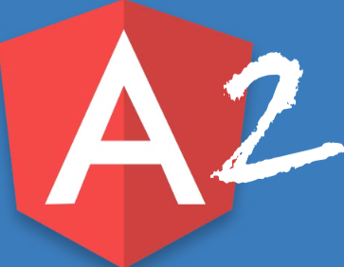
Angular 2
A Quick look

Slide 2
Agenda
Basic concepts and key changes
TypeScript
Components and directives
Attributes
Bindings
Structural Directives
Pipes
Router
Dependency Injection
Observables
Testing
A quick overview

Slide 3
Angular 2: What’s new?
Forget about $scope, $watch, $digest! (Hello Zone.js!)
Forget about controllers; It’s now Component!
Directive is just a component with a selector
TypeScript rules!
How about adding static types, class based OOP, interfaces, generics, attributes (decorators), lambda expressions, … to JavaScript?
Everything* is modular.
It’s time to learn some RxJS

Slide 4
Component
Template
View layout (usually html)
Class
Properties
Methods
Metadata
Extra data (defined using decorators)

Slide 5
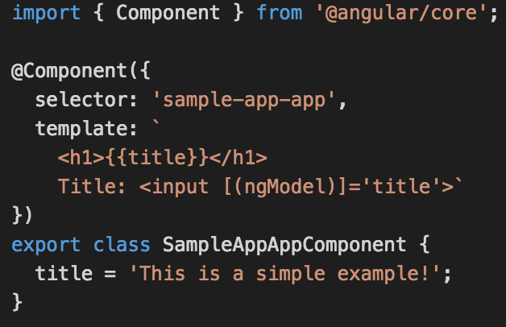
Simple Component

Slide 6
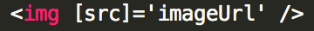
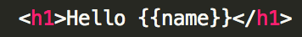
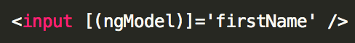
Bindings
Property binding (one way from class to template)
Event binding (one way from template to class)
Interpolation (one way from class to template)
Two way binding (a.k.a. Banana in the Box [()] )

Slide 7
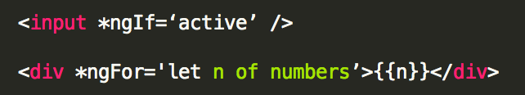
Structural directives
Change the structure of the page
Prefix with an asterisk
Examples:

Slide 8
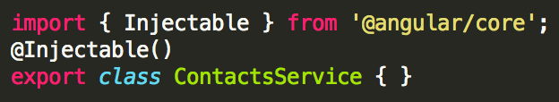
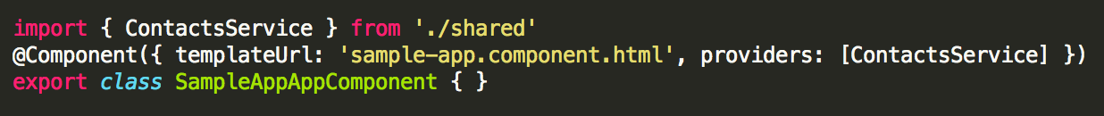
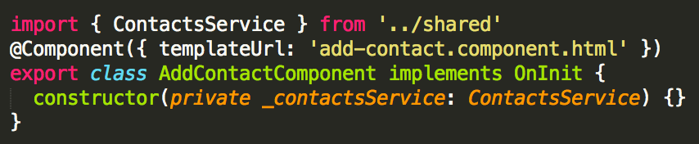
Services (DI in angular 2)
Service is just a class with @Injectable decorator
Registered in a high level component
Automatically injected in sub-components

Slide 9
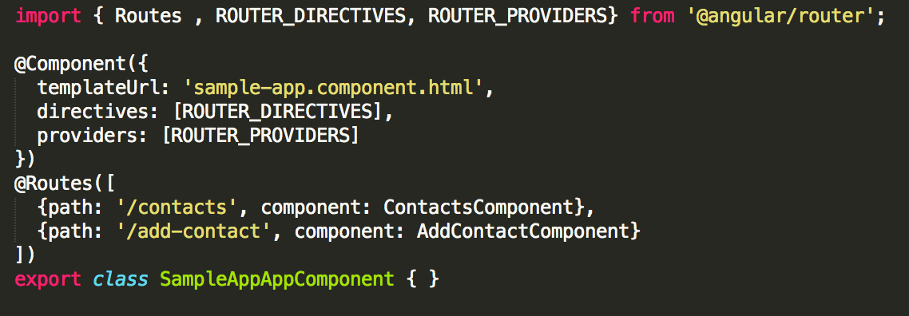
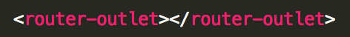
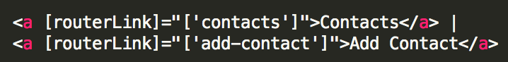
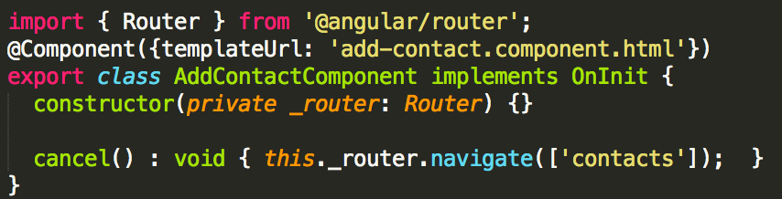
Routes
Configuring routes
Adding placeholder
Using in templates
Using in components

Slide 10
Setting up an angular 2 project
Folder structure
Module loader (Usually SystemJS)
Development server (for ModuleLoader)
Transpiler (for TypeScript)
Shims and Polyfills
Dependencies (RxJS, ZoneJS, …)
Required Angular modules
@angular/core, @angular/common, @angular/router, …
Testing (unit testing and e2e testing)
And a bunch of files and configurations for each Component, Service, Route, …

Slide 11

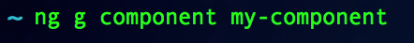
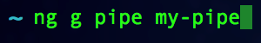

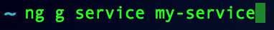


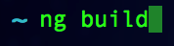
Getting started using angular-cli (The Easy way)
Install angular-cli
Start a new project
Generating other scaffolds
Publish project

Slide 12

Demo
https://github.com/mahdi-ninja/SampleAngular2App

